Slide 1
XBUS-504
Data Analysis I: Statistics
David Waterman, Instructor
Georgetown University School of Continuing Studies
Spring 2019

Slide 2

About the Instructor
2017-Present, Data Scientist at U.Group (formerly ByteCubed & Chief) “As a data scientist, I’m always exploring new technologies, new algorithms, and new ideas. I’m lucky to work in an environment where we are encouraged to try out new things, and to teach each other what we discover. Previously I was a teacher, and I taught across the entire spectrum of high school math courses, with a personal focus on AP Statistics. I enjoy the pursuit of knowledge and sharing that knowledge with others.”
2008-2017, High School Math Teacher 2003-2007, Systems Engineer
Education: B.S. in Computer Science, James Madison University M.S. in Mathematics with concentration in Teaching, University of the District of Columbia

Slide 3



Personal Data
Live in Richmond, VA
Enjoy outdoor activities:
Trail running
Mountain Biking
Rock Climbing
Enjoy mechanical work:
Bicycles
Motorcycles
Welding
DIY/Small construction
Love my pups
Bentley
Widget
Walley

Slide 4
Do Now: Tell Me About You
Email me at dw858@georgetown.edu:
Subject: XBUS-504 Student
Body: Your name & email address
What is your previous experience with Statistics?
What do you hope to get out of this course?
Your Github and LinkedIn URLs

Slide 5
Goals for the Course
This course reviews the basics of descriptive and inferential statistics, distributions, probability, and regression with a specific focus on providing a groundwork of understanding for the methods used in Data Science.
Course Objectives
Explain descriptive and inferential statistics.
Compute probabilities, measures of central tendency, and variance.
Produce and interpret meaningful and accurate summary statistics.
Conduct hypothesis tests and understand Type I and Type II errors.
Develop single and multivariate regression models.
Differentiate between correlation and causation.

Slide 6
Certificate Course Schedule
Foundations of Data Analytics and Data Science Software Engineering for Data Data Sources and Storage Data Ingestion and Wrangling Data Analysis I: Statistics Data Analysis II: Machine Learning Visual Analytics Applied Data Analytics

Slide 7
Planned Agenda
Day 1
Section 1: Descriptive Statistics
● Categorical & Quantitative Data
● Displaying Quantitative Data
● Describing Quantitative Data
● Location in a Distribution
● Density Curves
● Common Types of Distributions
Section 2: Relationships
● Scatterplots & Correlation
● Single Regression
● Experimental Design & Causation
● Sampling Techniques: Uniform, Stratified, and Poisson
Section 3: Probability
● Randomness & Probability
● Simulation & Stochastic Computing
● Probability Rules
● Joint Probability Distributions, Conditional Probability & Independence
● Bayesian Probability: prior and posterior distributions
Day 2
Section 4: Inferential Statistics
● Sampling Distributions
● Confidence Intervals: Basics
○ Estimating a Population Proportion
○ Estimating a Population Mean
● Significance Tests: Basics
○ Tests about a Population Proportion
○ Tests about a Population Mean
● Type I and Type II errors
Section 5: Advanced Topics
● Chi-Square Tests
● ANOVA: Execution & Interpreting
● General Linear Models & Multivariate Regression
● Evaluating Regression Models

Slide 8
Download the Course Data & Configure Your Environment
Clone the course repo from github and install the Python packages needed. Open the 0_Config_Test.ipynb notebook and try running the cells to test your install.
$ git clone https://github.com/georgetown-analytics/XBUS-504-01.Data_Analysis_I_Statistics.git $ cd XBUS-504-01.Data_Analysis_I_Statistics/ $ pip install -r requirements.txt $ cd notebooks/ $ jupyter notebook 0_Config_Test.ipynb
If you use virtual environments, create one now

Slide 9
Brief Notes on Memory & Learning
Notes:
Differences between short term, medium term, and long term memory and methods for enhancing storage in long term memory (repetition).

Slide 10
Section 0: Definitions

Slide 11
What is Statistics?
Statistics is a branch of mathematics dealing with the collection, analysis, interpretation, and presentation of masses of numerical data.

Slide 12
The 2 Main Branches of Statistics
Descriptive Statistics: Describe a set of data Examples: Mean, median, standard deviation, IQR Skew, Kurtosis Correlation Display (Boxplot, histogram, scatterplot, table, etc)
Inferential Statistics: Infer information based on available data Examples: Regression (Modeling relationships) Confidence Interval (Predicting values) Significance Test (Predicting outcomes)

Slide 13
Why is Statistics important in Data Science?
Data Science uses scientific methods, processes, algorithms and systems to extract knowledge and insights from data.
Extracting knowledge from data = Descriptive Statistics
Extracting insights from data = Inferential Statistics
The work being done in the field of Data Science has become incredibly complex, but at the core it is using computer programming to apply statistical analysis on a scale beyond the ability of an individual.
If you understand the underlying statistics, you will have a stronger foundation for building your Data Science skills.

Slide 14
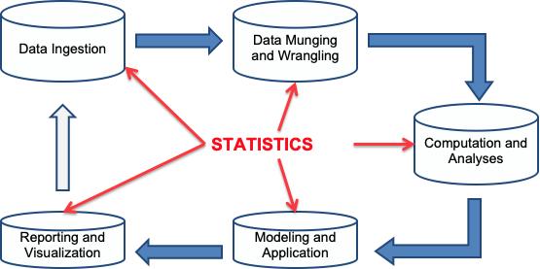
The Data Science Workflow

Slide 15
Key Terms
A population is the collection of all items of interest or under investigation N represents the population size
A sample is an observed subset of the population n represents the sample size
A parameter is a specific characteristic of a population
A statistic is a specific characteristic of a sample

Slide 16
Examples of Populations
Ages of all registered voters in the United States
Incomes of all families living in Daytona Beach, FL
Annual returns of all stocks traded on the New York Stock Exchange
Why should we bother with sampling?
Notes:
Time, resource constraints
Some populations are infinite
representative of the population
sufficiently large
properly selected (for the analysis…)

Slide 17
Examples of Sampling
Consider a researcher for a soft drink company who wants to determine the sweetness preferences of Americans between the ages of 15 and 25.
What’s the population?
In order for a sample to be unbiased, it must be
Representative of the population
Randomly selected
Sufficiently large
Notes:
The population in this example is finite and includes every American in this age group.
Gathering data from every individual in this population would be nearly impossible and prohibitively expensive.
’bias’ is a technical term we will revisit, what does it mean to you?

Slide 18
Section 1: Descriptive Statistics

Slide 19
Types of Data
Data
Categorical
(Qualitative)
Numeric
(Quantitative)
Discrete
Continuous
Ordinal
Notes:
Ordinal Data can be ordered and assigned numbers, but those numbers do not indicate value.
Ex: Freshman, Sophmore, Junior, Senior
Ecstatic, Happy, Neutral, Unhappy, Extremely Depressed
Star ratings e.g. Yelp

Slide 20
Describing Quantitative Data

Slide 21
Measures of Central Tendency, Variance & Skew
(AKA Center, Spread, and Shape)
Generally, when describing a distribution of quantitative data, the properties of center, shape, and spread give a good general overview of the key properties of the distribution. They provide a quick starting point and can inform how you interpret more detailed descriptions of the distribution.

Slide 22
Measures of Center
Mean
Median
(Mode)

Slide 23
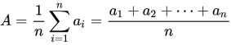

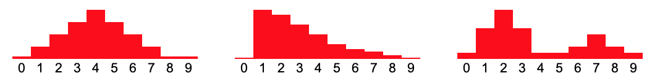
Mean
Key points:
Arithmetic mean = average = Sum of values / number of values =
μ = Greek letter mu = mean of a population
= x bar = mean of a sample
Is the balance point of the distribution

Slide 24
Percentile
The value below which a given percentage of observations in a group of observations falls. For example, the 20th percentile is the value (or score) below which 20% of the observations may be found.
Explain what it means if your GPA is in the 91st percentile for your class.

Slide 25
Median
Key points:
Median = middle value =
The median of a finite list of numbers can be found by arranging all the numbers from smallest to greatest.
If there is an odd number of numbers, the middle one is picked.
If there is an even number of observations, then there is no single middle value; the median is then usually defined to be the mean of the two middle values.
Is the 50th percentile
Is the 50/50 point of the distribution (equal areas)

Slide 26
Measures of Center: Key Points
Median is resistant, mean is not
Therefore mean gets pulled in the direction of skew compared to median
Additionally, mean gets pulled by extreme values, median does not. This makes median a more robust measure of center.
Explore:
http://digitalfirst.bfwpub.com/stats_applet/stats_applet_6_meanmed.html

Slide 27
Measures of Spread
Variance & Standard Deviation
IQR
Range

Slide 28
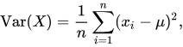
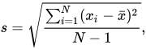
Variance & Standard Deviation
Variance is the expected value of the squared distance from the mean.
Standard Deviation is the expected distance from the mean.
𝜎 = Standard Deviation of a Population
s = Standard Deviation of a Sample

Slide 29
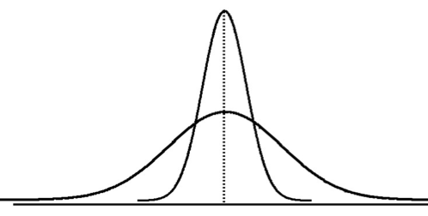
Visualizing Standard Deviation
Smaller Standard Deviation
Larger Standard Deviation

Slide 30
IQR - Interquartile Range
IQR, or Interquartile Range, is the distance between the quartiles Q1 and Q3. The quartiles occur at the 25th and 75th percentiles of a distribution. Recall that the median is the 50th percentile. So, Q1 is the median of the bottom half of the data and Q3 is the median of the top half of the data.
IQR = Q3 - Q1, so to calculate IQR, first find Q1 and Q3:
Example: 1, 2, 5, 6, 7, 9, 12, 15, 18, 19, 27
Do you think IQR is a more resistant measure of spread than standard deviation?
Notes:
Yes, IQR is more resistant. It really only depends on 2 values, so it will not be affected by extreme high or low values.

Slide 31
Range
Range is simply the distance from the minimum to the maximum value.
Range = Max - Min
Is range a robust measure of spread?
Notes:
No, range is not robust/resistant.

Slide 32
Measures of Spread: Key Points
Standard Deviation typically accompanies mean (since mean is required to calculate Standard Deviation)
Like mean, Standard Deviation is not resistant to extreme values or skew, it is calculated from every value in the data set
IQR typically accompanies median (since median is required to calculate IQR)
Like median, IQR is resistant to extreme values or skew, it uses the position of values but is only calculated from 2: Q1 and Q3
Standard Deviation = √Variance Standard Deviation and IQR both have the same units as the original data

Slide 33
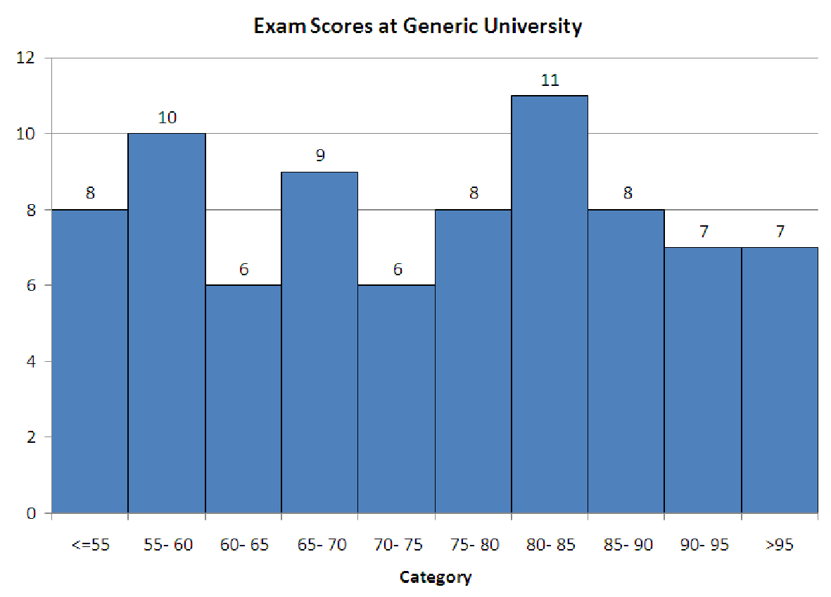
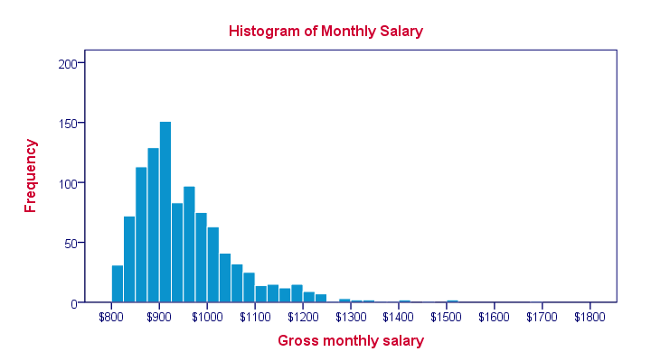
How to choose Mean/St Dev. vs. Median/IQR
Generally we prefer to report mean and standard deviation, unless a data set has many extreme values or significant skew, because mean and standard deviation take into account all values in your data set. Examples:

Slide 34
Shape
Symmetry or Skew
Peaks (Unimodal, bimodal, bell-shaped)
Kurtosis (Incl. uniform)

Slide 35
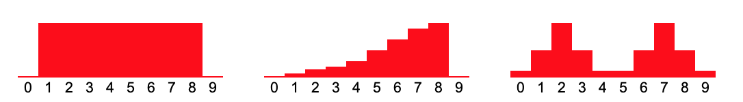
Symmetry and Skew
Data can be symmetric, if the left half and right half follow roughly the mirror distribution of each other.
When they are displayed graphically, some distributions have many more observations on one side of the graph than the other. Distributions with fewer observations on the right (toward higher values) are said to be skewed right; and distributions with fewer observations on the left (toward lower values) are said to be skewed left.

Slide 36
Peaks (Unimodal, Bimodal, bell-shaped)
Distributions can have few or many peaks. Distributions with one clear peak are called unimodal, and distributions with two clear peaks are called bimodal. When a symmetric distribution has a single peak at the center, it is referred to as bell-shaped.

Slide 37
Density Curves and Common Types of Distributions

Slide 38
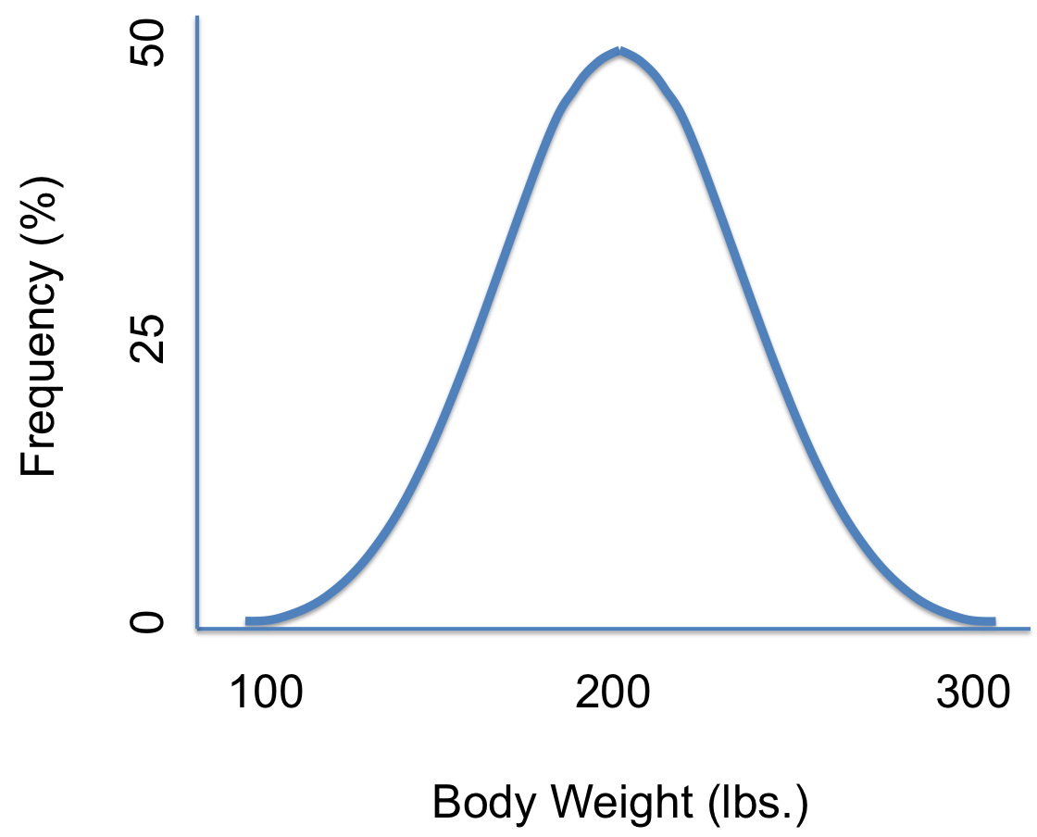
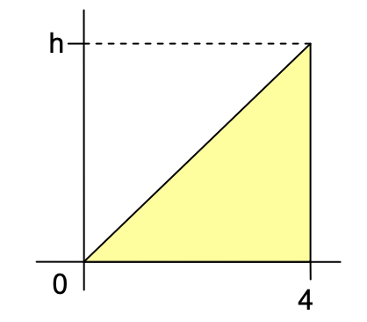
Density Curves
A density curve is a graph showing the probabilities of different values occurring for a distribution. The higher the graph at a given point, the greater the likelihood that that value will occur. The area under a density curve is the probability for that range.

Slide 39
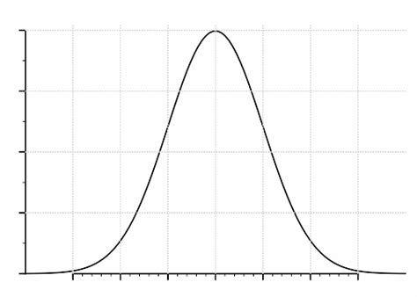
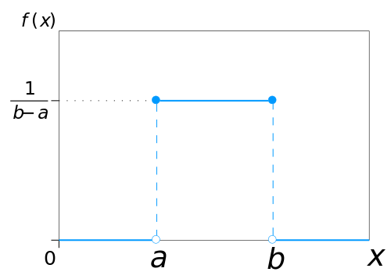
Density Curves: Key Points
The total area under a density curve is always 1.0 (100%)
Density curves represent continuous data (any value in a range)
The probability for a given range is the area under the density curve for that range
Common shapes of density curves are:
Bell-shaped (Normal, t, Logistic, and more)
Uniform (flat)

Slide 40
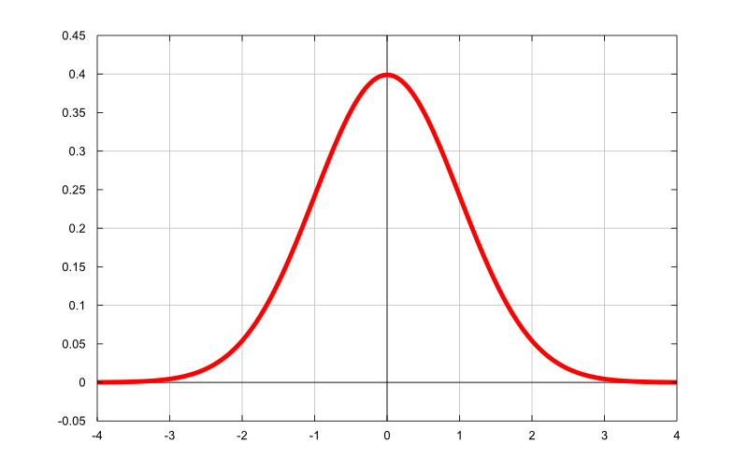
Normal Distribution
The normal (or Gaussian or Gauss or Laplace–Gauss) distribution is a very common continuous probability distribution. It is bell-shaped, but not all bell-shaped distributions are Normal! Do not call a distribution Normal unless you know or have evidence to believe it is.

Slide 41
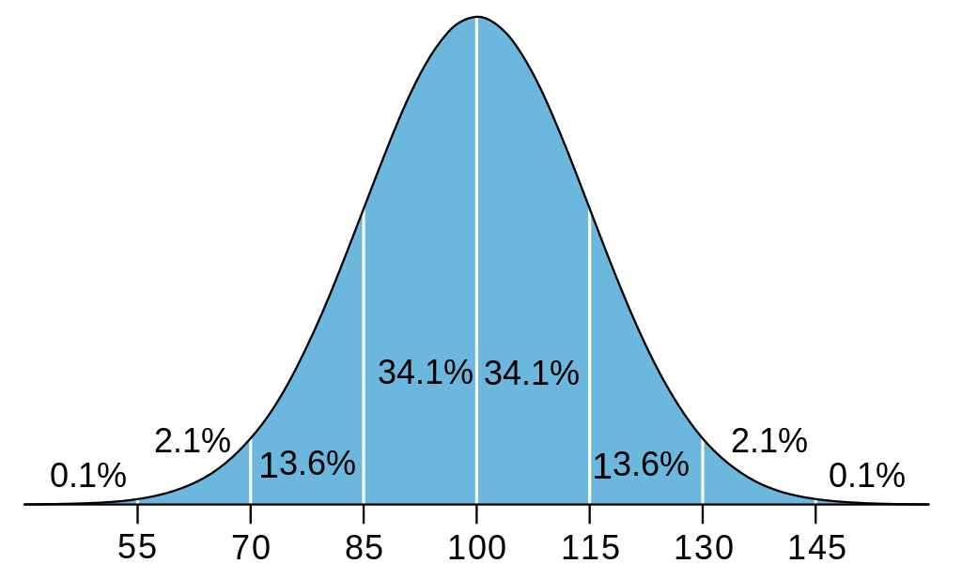
Normal Distribution
A Normal distribution is defined by it’s mean μ and standard deviation 𝜎. A shorthand notation is N(μ, 𝜎), i.e. N(100, 15). A Normal distribution with a mean of 0 and standard deviation of 1 is called a Standard Normal Distribution.

Slide 42
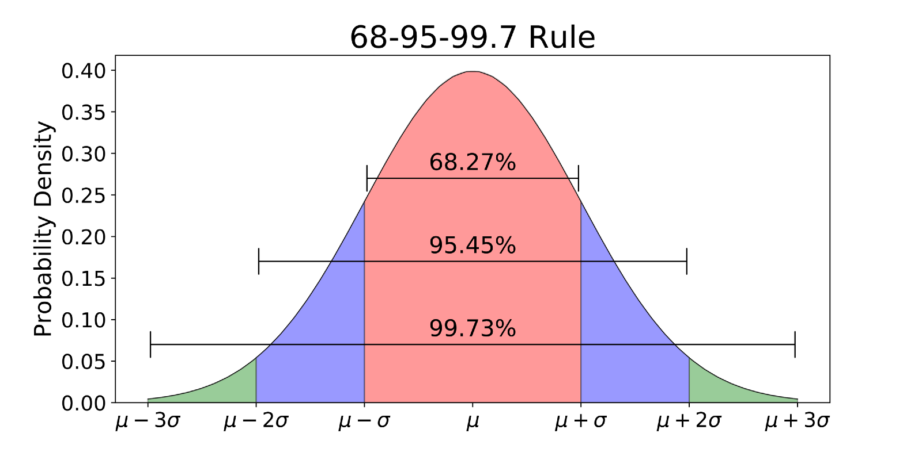
68-95-99.8 Rule
Because all Normal distributions have the same center, spread, and shape, if you know a distribution is Normal you can calculate areas and probabilities from it quickly.

Slide 43
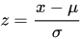
Z-Score
The Z-score is the number of standard deviations above or below the mean a single value is. It gives us a general idea of how common or uncommon a value is. The 68-95-99.7 rules uses Z-scores of +/- 1, +/- 2, and +/- 3. The formula is:
Example:
The scores for a test had a distribution of approximately N(80, 8). You scored a 93, and your friend scored a 61. What were your Z-scores? What does that tell you? Can you make a sketch of the distribution and where your scores were?
Notes:
Z(you) = (93-80)/8 = 1.625
Z(friend) = (61-80)/8 = -2.375

Slide 44
Normal Density Curve: Interactive Applet
http://digitalfirst.bfwpub.com/stats_applet/stats_applet_7_norm.html

Slide 45
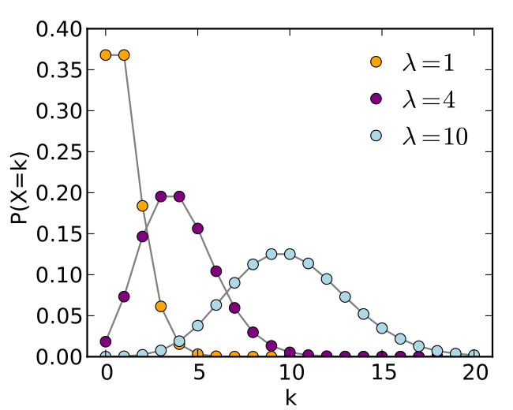
Poisson Distribution
The Poisson Distribution expresses the probability of a given number of events occurring in a fixed interval of time or space if these events occur with a known constant rate and independently of the time since the last event.
This is particularly valuable for time-series data.
Examples of time series data include:
Sensor data (temperature, traffic, people in a store)
Daily ridership on a bus
Monthly home sales
k = true number of occurrences
𝝀 = expected number of occurrences

Slide 46
Other Important Types of Distributions
There are many different types and shapes of distributions. We will discuss more of these later, some are bell-shaped and some are not. Just keep in mind that there are infinite types of distributions, and these are some of the most common:
Gaussian (Normal), t-distribution, Poisson, Bernoulli, Exponential, Gamma, and Multinomial

Slide 47
One More Descriptive Statistic in Section 1

Slide 48
Kurtosis
A positive value tells you that you have heavy-tails (i.e. a lot of data in your tails).
A negative value means that you have light-tails (i.e. little data in your tails).
This heaviness or lightness in the tails usually means that your data looks flatter (or less flat) compared to the normal distribution. The standard normal distribution has a kurtosis of 3, so if your values are close to that then your graph’s tails are nearly normal. These distributions are called mesokurtic.

Slide 49
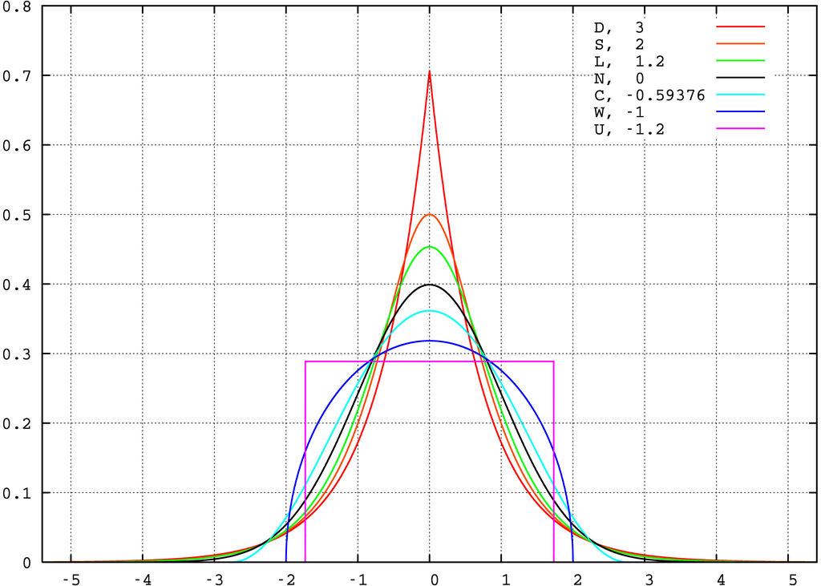
Kurtosis

Slide 50
Displaying Data

Slide 51

Goals for Presenting Data Graphically
Data in raw form are usually not easy to use for decision making
Some type of organization is needed (table, graph)
The type of graph to use depends on the variable being summarized
General goals for effective data presentation:
Present data to display essential information
Communicate complex ideas clearly and accurately
Avoid distortion that might convey the wrong message
This topic will be revisited in Course 7: Visual Analytics

Slide 52
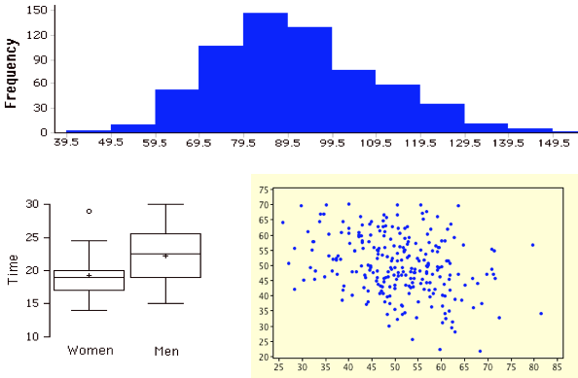
Examples of Graphical Displays
Notes:
Univariate vs. Univariate comparison vs. Bivariate

Slide 53
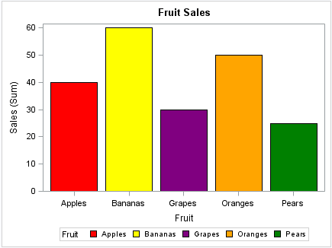
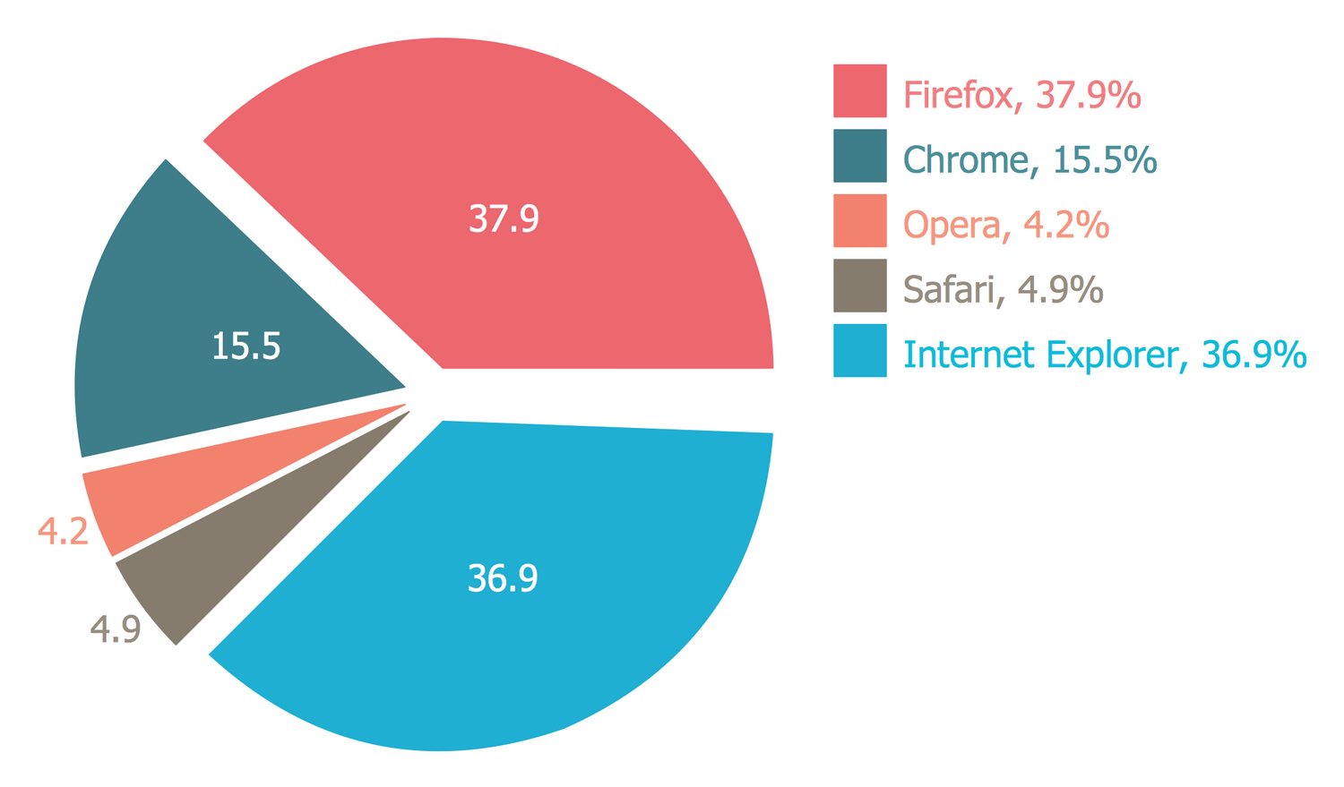
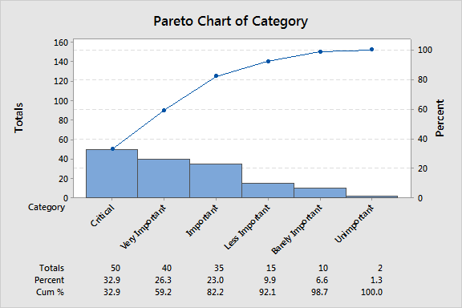
Common Display Types
Categorical:
Frequency distribution
Bar chart
Pie chart
Pareto diagram
Favorite Color | Frequency
Magenta | 4
Cerulean | 2
Black | 9

Slide 54
The Pareto Principle
In the 19th century, Vilfredo Pareto observed that 20% of the pea pods in his garden contained 80% of the peas. He was also an economist, and in 1896, he published a paper demonstrating that around 80% of the land in Italy was owned by 20% of the population.
The Pareto Principle describes any phenomenon where a small percentage of factors is responsible for a large percentage of the effect. A Pareto Diagram is a bar chart with the categories in descending order, and a line drawn on top showing the cumulative percentage, allowing you to easily find which categories are cause 80% of the effect, and which cause the remaining 20%.

Slide 55
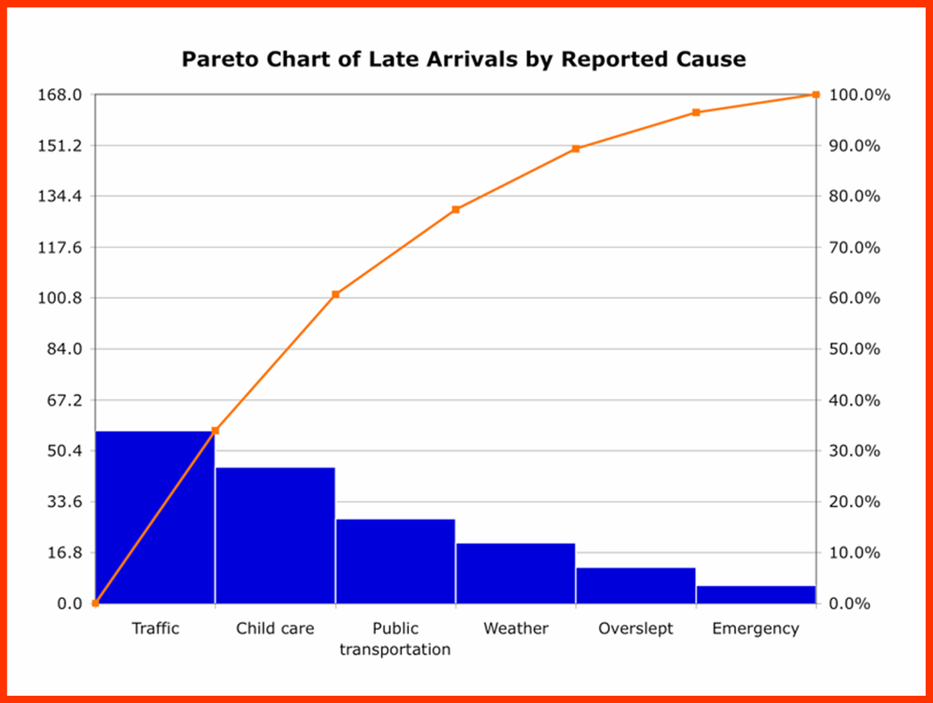
The Pareto Principle

Slide 56
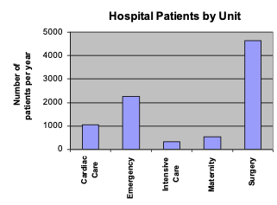
Frequency Distribution Table
Key Vocabulary:
Frequency = Count = Number of Occurrences
Hospital Unit | Number of Patients
Cardiac Care | 1,052
Emergency | 2,245
Intensive Care | 340
Maternity | 552
Surgery | 4,630
Notes:
Often the first display used when making other displays by hand
Without doing any other calculations, what kind of display could you make?
Careful to remember that ordering of categories does not imply value!

Slide 57
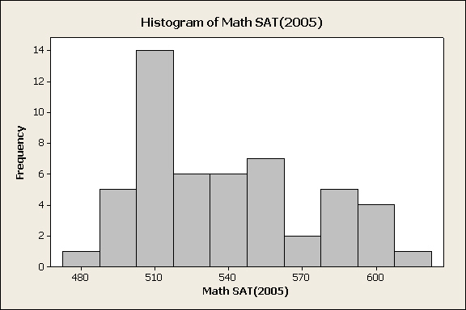
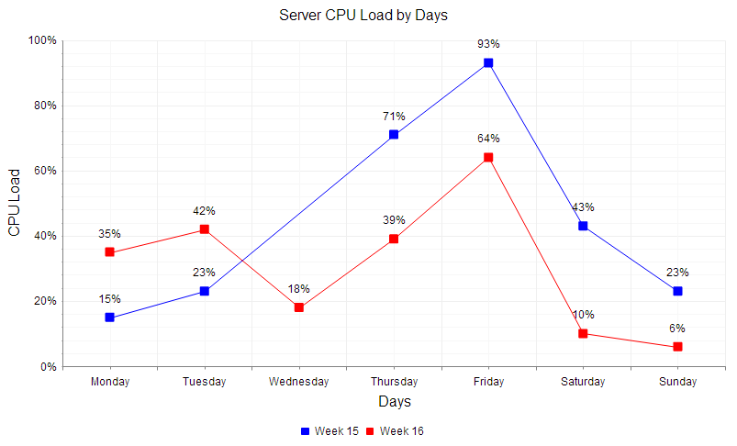
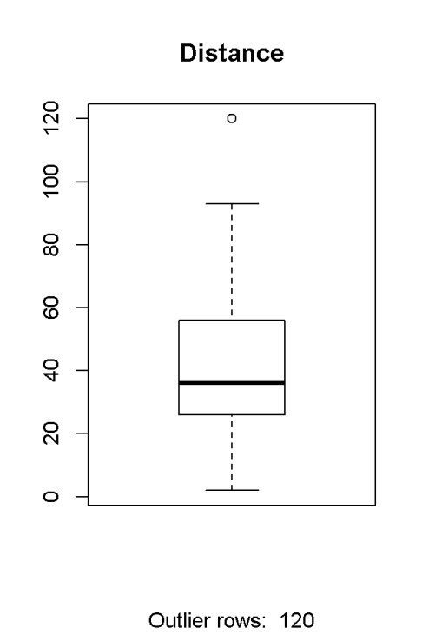
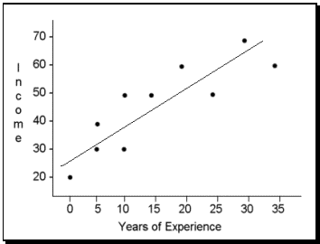
Common Display Types
Quantitative:
Line chart
Histogram and Ogive
Boxplot
Scatter plot
Notes:
Important: When neighboring values are connected, it indicates a relationship. When they are disconnected, it implies no relationship. That’s why on Bar Charts the bars do not touch, but on Histograms they do.

Slide 58
Learn By Doing: Make Histograms, Scatterplots, & Boxplots in Python
Let’s go to the repo and open Jupyter if you don’t have it open already:
$ jupyter lab (or $ jupyter notebook)
Now we’ll work through notebooks 1-1, 1-2, and 1-3.

Slide 59
A Quick Note on Notebooks
Notebooks are awesome for experimenting and exploration, but they enable bad habits.
https://www.youtube.com/watch?v=7jiPeIFXb6U
A few quick recommendations when using notebooks:
Always give them a name (No Untitled15.ipynb!)
Use markdown cells instead of comments for narrative (still use comments to describe code)
Always restart the kernel, clear all the output, and run again from top to bottom straight through before saving/sharing/distributing. A notebook that has code cell 10 above code cell 4 is a bad code smell.

Slide 60
Section 2: Relationships

Slide 61
Correlation
Correlation is used to describe the relationship between quantitative variables when you have bivariate or multivariate data. We will begin by exploring bivariate correlation.
If two variables are correlated, having information about one variable provides you additional information about the other.
Example: Because age and salary are strongly correlated, I know someone who is older is more likely to make more money than someone who is younger. It does not guarantee this relationship, but it tells me that it is likely.

Slide 62
Pearson Coefficient of Correlation: r
The Pearson correlation coefficient, r, is a number between -1 and 1 that indicates the strength and direction of the linear relationship between two variables.
r = 1 is a perfect, positive linear relationship (the data forms a straight line with a positive slope).
r = -1 is a perfect, negative linear relationship (straight line, negative slope).
r = 0 indicates there is no linear relationship between the variables
A non-zero value for r implies that knowing a value for the independent variable provides you some information about the dependent variable.
Notes:
Independent variable is the variable that is changed or controlled in an experiment, denoted by x. Dependent variable is the variable that is being tested or measured, denoted by y.

Slide 63
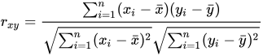
Pearson Coefficient of Correlation: r
We will use software to calculate the value of r, but note in the formula that it comes from the distance from each value’s x and y to the mean x and y.
Notes:
Independent variable is the variable that is changed or controlled in an experiment, denoted by x. Dependent variable is the variable that is being tested or measured, denoted by y.

Slide 64
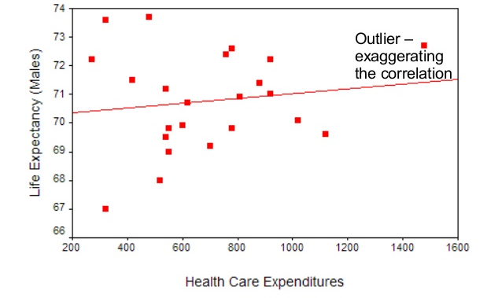
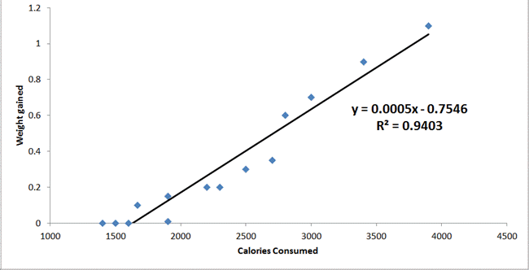
Visualizing Pearson Correlation

Slide 65
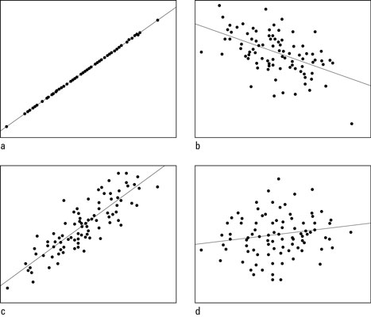
Visualizing r
1.0
Try to guess the correlation coefficient of each scatter plot:
Explore more for yourself: http://digitalfirst.bfwpub.com/stats_applet/stats_applet_5_correg.html
-0.5
0.15
0.85

Slide 66
Coefficient of Determination, r²
Often, r² is reported along with r. It has its own name and definition. r² is called the Coefficient of Determination. It describes what percent of the variability in y is explained by changes in x.
Example:
According to this scatter plot, approximately 94% of the change in weight gain is explained by change in calories consumed.
What could possibly explain the other 6% of change in weight gain?

Slide 67
Pearson Correlation Coefficient Key Points:
r gives you strength and direction of a linear relationship
r has no units
r assumes the data has linear and homoscedastic (data is equally distributed about the regression line). You can calculate r for any relationship, but it is only appropriate for linear relationships.
r close to 1 or -1 is a strong relationship, close to 0 is weak
The stronger the correlation, the more accurately you can predict y for a given x
r indicates a correlation, but does not indicate causation

Slide 68
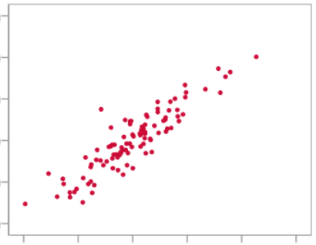
Correlation vs. Causation
Does this scatter plot imply that the independent variable causes change in the dependent variable?
Ice Cream Sales
Traffic Fatalities
Violent Crime
Consumption of Ham
Drowning Deaths
Michelin Star Restaurants

Slide 69
Correlation vs. Causation
Correlation does not imply causation.
There are many alternative explanations for a relationship between two correlated events A and B:
A causes B (direct causation);
B causes A (reverse causation);
A and B are consequences of a common cause, but do not cause each other (a confounding variable);
A and B both cause C, which is (explicitly or implicitly) conditioned on;
A causes B and B causes A (bidirectional or cyclic causation);
A causes C which causes B (indirect causation);
There is no connection between A and B; the correlation is a coincidence.

Slide 70

Correlation vs. Causation
Generally, to determine causation you must have a well-designed experiment or study.
https://xkcd.com/552/

Slide 71
Spearman Rank Correlation
The Pearson Correlation measures a linear relationship (when x increases by 1, y increases by a fixed amount), while Spearman Rank Correlation measures a monotonic relationship (when x increases by 1, y increases by a variable amount). Because of this, Spearman Correlation is more meaningful for data that is:
Non-linear (i.e. exponential, logarithmic, etc.), or
Ordinal (having rank but not value)
Otherwise, we can treat the Spearman Correlation Coefficient 𝜌 similarly to r. It takes values between -1 and 1, with 0 being no relationship and -1/1 being strong relationship, and it has no units.

Slide 72
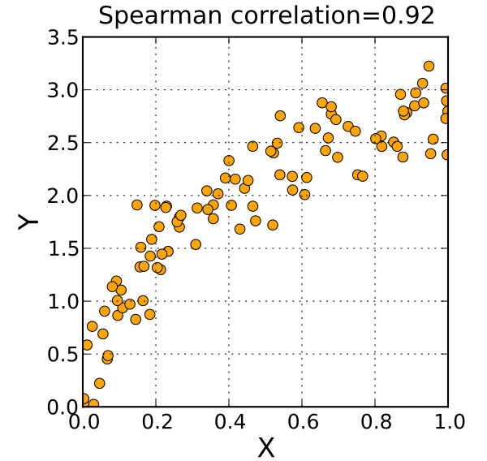
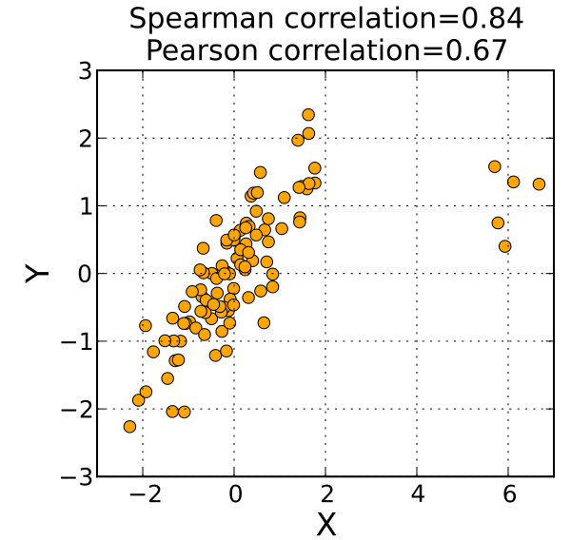
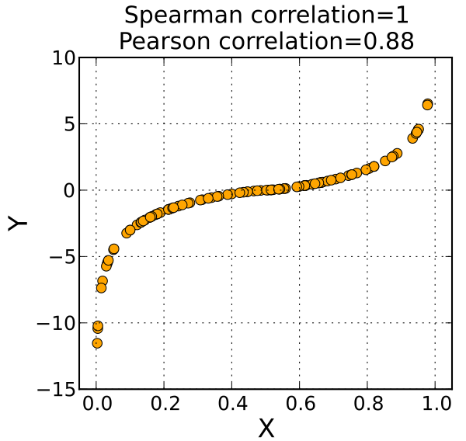
Spearman Rank Correlation Visualized

Slide 73
Simple Linear Regression (Single Regression)
Linear regression is a linear approach to modelling the relationship between a response (or dependent variable) and one or more explanatory variables (or independent variables). In this course we will focus on a single explanatory variable (aka single regression). Other forms of regression will be covered in the next course, Data Analysis II: Machine Learning.
The goal of all types of regression is to be able to make predictions of a dependent variable. When we fit a regression line, it gives us predictions of y for values of x.

Slide 74
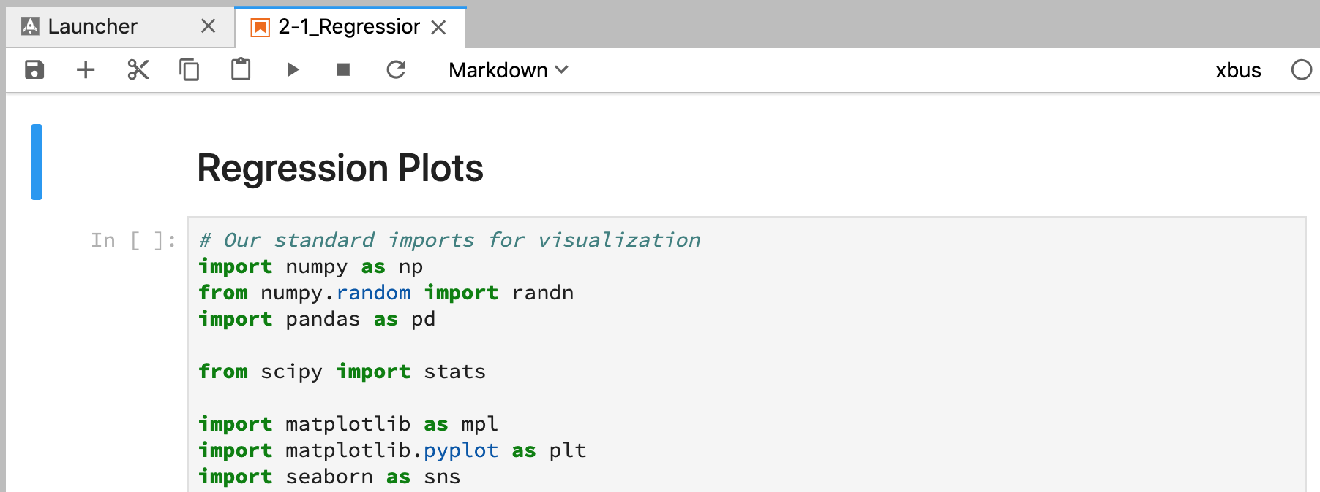
Learn by Doing: Regression
We will now work through notebook 2-1.

Slide 75
Sampling Techniques: Uniform, Stratified, and Poisson
Previously we mentioned that you can only determine causation from a well designed study or experiment. One feature of well designed studies and experiments is that they must use samples that accurately represent the populations we wish to model. If we wish to model the most popular food in DC but we only choose students in the GW Data Science program for our study, will it be representative of the entire DC population? What problems might this cause?

Slide 76
Sampling Techniques
In order to determine effective sampling, you must first know what the population of interest is. Then you can select an unbiased sample.
In order for a sample to be unbiased, it must be
Representative of the population
Randomly selected
Sufficiently large
What is bias? It is when a method is used that will consistently overestimate or underestimate the value we wish to know.

Slide 77
Biased Sampling Methods
Convenience Sampling - selecting members for your sample in a method that is most convenient (which will not be random)
Voluntary Sampling - allowing subjects to choose whether or not to participate
Notes:
Examples: Convenience - standing in a mall and surveying people who walk by, going door to door and surveying the first 10 houses that end in 3. Voluntary - online poll, randomly selecting people to mail postcards to and requesting they return them.

Slide 78
How to Sample Well: Types of Random Samples
Simple Random Sample (SRS, or Uniform) Stratified Random Sample Cluster Sampling Poisson Sample

Slide 79
Simple Random Sample
A Uniform Distribution is when all values are equally likely to occur. Similarly, a Uniform Sample or Simple Random Sample (SRS) is one in which all elements in the population are equally likely to be chosen for the sample.
There are many ways to perform an SRS, such as putting elements on slips of paper, putting them in a hat, mixing the slips of paper together, and then choosing the number of slips needed for your desired sample size. Generally we will use a random number generator (or a function based on random numbers) to select elements for a sample.
Notes:
Sidenote: What does the density curve of a uniform distribution look like?

Slide 80
Visualizing Simple Random Sampling
http://digitalfirst.bfwpub.com/stats_applet/stats_applet_13_srs.html
Notes:
Is it possible to select a random sample of numbers 1-100 and get numbers 1-10? 91-100? 10, 20, 30, ...100? It is possible to think you see a pattern in random occurrences?

Slide 81
Stratified Random Sample
Imbalanced data is a major issue in statistics. What is imbalanced data?
Let’s say I run a credit card company that has 1,000 customers. Of those customers, 23 are in default on their payments, and the other 977 have all paid on time (the defaulters are called the minority class ).
If I take a Simple Random Sample of 10 cardholders, how many would you expect to be in default?
What if I take an SRS of 100 cardholders?
In classification problems, this is called class imbalance.

Slide 82
Stratified Random Sample
If I used Simple Random Sampling with my credit card holders, I will rarely get enough defaulters in my sample to give me useful information about that minority class.
I need to change my sampling method to guarantee I get a certain amount of defaulters in my sample so I have a large enough sample of them to allow me to make meaningful conclusions about them.
I don’t want to just choose the 5 defaulters with the most debt, I still need to randomly select them to make sure they are representative of all the defaulters, but I will separate my population into strata (groups) before randomly choosing the sample.

Slide 83
Stratified Random Sampling Key Points
Useful when you have prior knowledge of a class imbalance in your data
To perform, break your population into strata based on prior knowledge, then perform Simple Random Sampling from each strata.
The samples drawn from each strata do not have to be proportional to the original data, it is at your discretion how many elements to select from each strata.

Slide 84
Section 3: Probability

Slide 85
Intro to Probability
Probability is the measure of the likelihood that an event will occur.
Probability is quantified as a value between 0 and 1, where 0 indicates impossibility and 1 indicates certainty.
For an event, the sum of all possible outcomes is always 1.
The symbol representing a probability is usually p.
Although in statistics we almost always prefer probabilities to percentages, in common use the reverse is true. Percentage = 100 × probability.
I.e. p = .437 → 100 × p = 43.7%

Slide 86
The Law of Large Numbers
Probability describes the expected outcome over a long series of events.
Probability can be used to discuss the likelihood of a single event occurring, but probability as a value only holds over many trials.
This is explained in the Law of Large Numbers, which states:
The average of the results obtained from a large number of trials should be close to the expected value, and will tend to become closer as more trials are performed.

Slide 87
Visualizing Law of Large Numbers
http://digitalfirst.bfwpub.com/stats_applet/stats_applet_10_prob.html
http://digitalfirst.bfwpub.com/stats_applet/stats_applet_11_largenums.html

Slide 88
Simulation
We will learn rules and formulas for calculating probabilities, but in many cases it is more practical to use the processing power available to us to perform simulations of many, many repeated trials to get a meaningful estimate of our desired parameter.
Some situations do not lend themselves to precise mathematical treatment. Others may be difficult, time-consuming, or expensive to analyze. In these situations, simulation may approximate real-world results; yet, require less time, effort, and/or money than other approaches.

Slide 89
Simulation & Stochastic Computing
A stochastic simulation is a simulation that traces the evolution of variables that can change stochastically (randomly) with certain probabilities.
This is an area that computers excel in. We have already seen simple examples with coins and dice. We can easily construct a more complicated example, such as: Flip 2 coins and roll two dice. What is the probability that you get 2 heads and both dice show either 5 or 6?
With the probability rules we will learn, we will be able to calculate the total probability. But we can do it without knowing those rules by creating a model in Python and running a simulation.

Slide 90
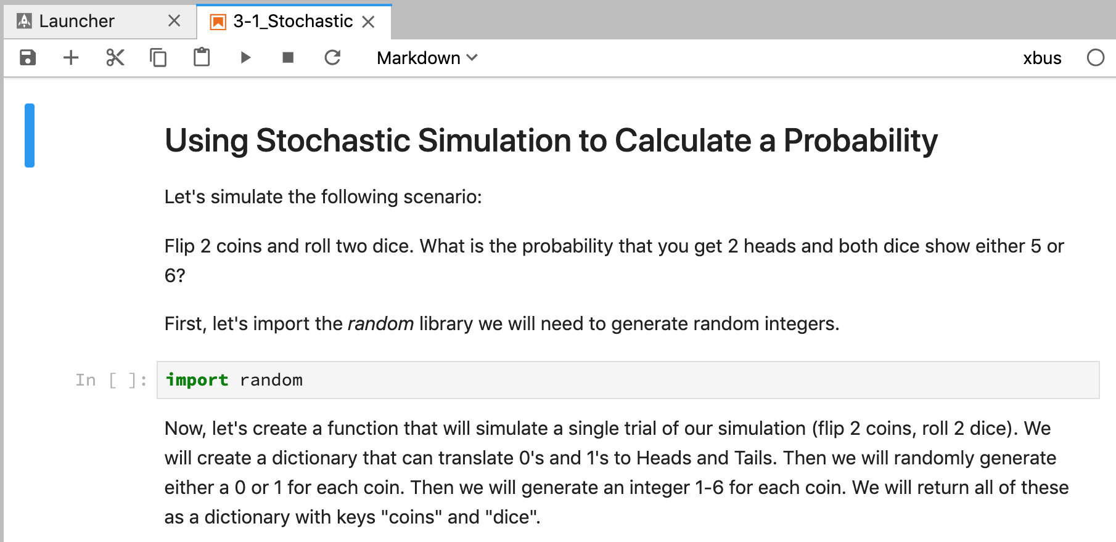
Simulation & Stochastic Computing
Now let’s work through notebook 3-1.

Slide 91
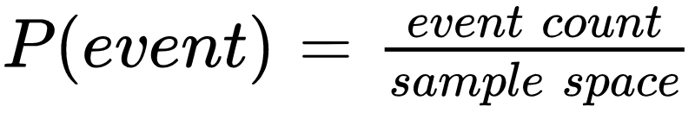
Basic Probability Rules
A random variable is the outcome of a random event. Ex: Let the random variable X represent the result of rolling a die.
The sample space of a random variable is all possible values of that variable. The sample space of a probability distribution contains all the possible outcomes in that distribution.
The probability of an event is equal to the number of outcomes in the event divided by the total number of outcomes.

Slide 92
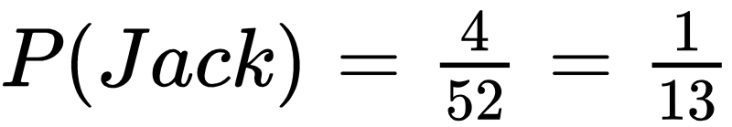
Probability Example
What’s the probability of drawing a card from a standard deck and drawing a jack?
What is the count of all possible outcomes (i.e. how many cards in the deck)?
What is the count of the event (i.e. how many jack cards in the deck)?

Slide 93
Probability Example
What’s the probability of flipping a coin 3 times and getting exactly 2 heads?
What is the count of all possible outcomes (i.e. how many possible ways can your 3 flips come out)?
What is the count of the event (i.e. how many different ways can you get 2 heads)?

Slide 94
Probability Assumptions
The coin is fair (P(H) + P(T) = 0.5)
Each coin flip is independent (one coin flip does not affect the outcome of any other)
If I shuffle a deck of cards, and I draw 5 cards in a row, is each card independent?
If I flip a coin 5 times, are the coin flips independent?
If I flip a fair coin 5 times and get heads every time, what are the chances that I get tails on the next flip?
Notes:
The card draws are not independent. Every time you take a card out of the deck, you can no longer draw that card the next time. There’s no way to draw 5 Aces!

Slide 95
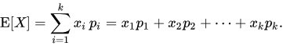
Expected Value of a Discrete Random Variable
The Expected Value or mean of a discrete random variable is the weighted average of its possible values, weighted by the probability of those values.
For a die, the probability distribution is:
The formula for Expected Value of a random variable is:
X | 1 | 2 | 3 | 4 | 5 | 6
P(X) | 1/6 | 1/6 | 1/6 | 1/6 | 1/6 | 1/6

Slide 96
Expected Value of a Discrete Random Variable
To calculate the Expected Value of a die roll:
E(X) = 𝜇 = 1(⅙) + 2(⅙) + 3(⅙) + 4(⅙) + 5(⅙) + 6(⅙) = 3.5
X | 1 | 2 | 3 | 4 | 5 | 6
P(X) | 1/6 | 1/6 | 1/6 | 1/6 | 1/6 | 1/6

Slide 97
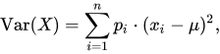
Variance and Standard Deviation of a Discrete Random Variable
Recall: What is the relationship between Variance and Standard Deviation? What do they measure?
The formula for variance of a discrete random variable is:

Slide 98
Variance and Standard Deviation of a Discrete Random Variable
To calculate variance and Standard Deviation of a die roll:
Var(X) = ⅙(1-3.5)² + ⅙(2-3.5)² + ⅙(3-3.5)² + ⅙(4-3.5)² + ⅙(5-3.5)² + ⅙(6-3.5)² = 2.917
𝜎 = √ Var(X) = √2.917 = 1.708
Using our previous definition of standard deviation, explain what this means.
X | 1 | 2 | 3 | 4 | 5 | 6
P(X) | 1/6 | 1/6 | 1/6 | 1/6 | 1/6 | 1/6

Slide 99

Random Variable Example: Roulette
In the casino game roulette, a wheel with 38 slots is spun and a ball is tossed on it, eventually landing in a single slot. The slots are numbered and colored with the following distributions:
16 red, 16 black, 2 green
16 odd, 16 even, 2 zero (0 and 00)

Slide 100
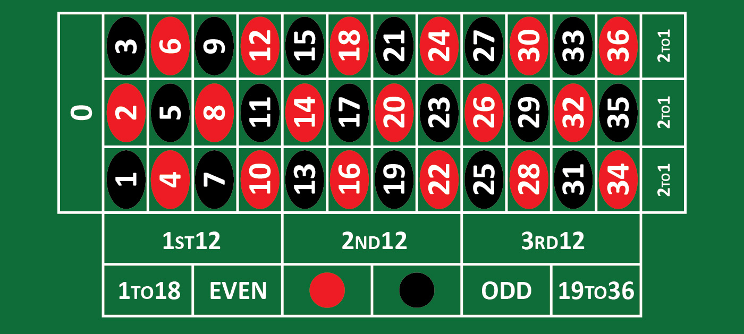
Random Variable Example: Roulette
This is the layout of a standard roulette table and illustrates some of the ways you can make a bet:

Slide 101
Random Variable Example: Roulette
Two possible bets are a red/black bet, and a corner bet.
If you bet $1 on a single color, you have a 18/38 chance of winning $1 payout.
If you bet $1 on a corner (4 numbers), you have a 4/38 chance of winning an $8 payout.
Red |  |  |  | Corner
X | $1 | -$1 |  | X | $8 | -$1
P(X) | 18/38 | 20/38 |  | P(X) | 4/38 | 34/38

Slide 102
Random Variable Example: Roulette
Based on the Probability distribution show, the means and standard deviations of the two bets are as follows:
Red bet: Mean = -$0.05, Standard Deviation = $0.998
Corner bet: Mean = -$0.05, Standard Deviation = $2.762
Explain what this means and how the two bets compare.
Red |  |  |  | Corner
X | $1 | -$1 |  | X | $8 | -$1
P(X) | 18/38 | 20/38 |  | P(X) | 4/38 | 34/38

Slide 103
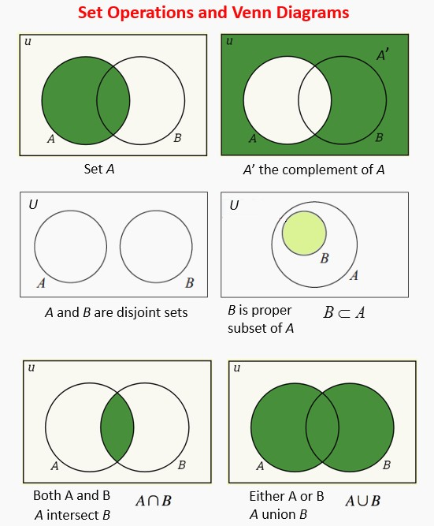
Joint Distributions
Symbol Definitions
⊂ = Subset of
⊆ = Subset of or equal to
∅ = Null, the empty set (no elements)
∪ = Union = Or
∩ = Intersection = And
A’ = Complement of A = Everything except A

Slide 104
Basic Probability Facts
0 ≤ P(A) ≤ 1 for any event A
Since 0 ≤ |A|/|S| ≤ 1 whenever A⊆S
P(∅) = 0
P(S) = 1 if S is the sample space
P(A’) = P(S - A) = 1 - P(A)
P(A∪B) = P(A) + P(B) if A∩B = ∅
P(A∪B) = P(A) + P(B) - P(A∩B) for any events A, B

Slide 105
Disjoint
Events A and B are disjoint or mutually exclusive if they have no common outcomes.
The previous slide said:
P(A∪B) = P(A) + P(B) if A∩B = ∅
P(A∪B) = P(A) + P(B) - P(A∩B) for any events A, B
Consider how these two rules are related to the concept of disjoint sets.

Slide 106
Comparing Complex Probabilities
Which is more likely when you draw a card from a standard deck?
A: That you will draw a card that is either a red card or a face card B: That you will draw a card that is neither a face card nor a club
The sample space for both is 52, so the probabilities will have the same denominator. Let’s focus on the numerators.

Slide 107
Comparing Complex Probabilities
A: That you will draw a card that is either a red card or a face card
P(red ∪ face) =
B: That you will draw a card that is neither a face card nor a club
P(face ∪ club)’ =
P(red) + P(face) - P(red ∩ face) =
(26 + 12 - 6)/52 = 32/52
1 - ( P(face ∪ club) ) =
1 - ( P(face) + P(club) - P(face ∩ club) ) =
1 - ( (12 + 13 - 3)/52 ) = 1 - (22/52) = 30/52
Conclusion: You are more likely to draw either a red or face card than neither face or club card.

Slide 108
Conditional Probability
Conditional probability is a measure of the probability of an event given that another event has occurred.
For events A and B, the notation for The Probability of event A occurring given that event B has occurred is:
P(A|B)
Example: The probability that if you draw a face card it is a jack:
P(jack|face)

Slide 109
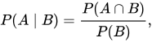
Conditional Probability
P(A|B) may or may not be equal to P(A)
If and only if (iff) P(A|B) = P(A), then events A and B are said to be independent.
The formula for conditional probability in all cases is:
This can also be rewritten as a formula for the intersection P(A ∩ B):
Notes:
We have already defined independent, what does it mean?

Slide 110
Conditional Probability
Let’s look a little closer at conditional probability for independent events:
If I roll a die and flip a coin, the outcomes are independent (why?)
If I want to calculate the probability of getting heads on the coin given that I roll a 6 on the die, I can show that P(heads|6) = P(heads). Let’s list the sample space:
1H 2H 3H 4H 5H 6H 1T 2T 3T 4T 5T 6T
What is the total probability of heads?
What is the probability of heads given 6?
6/12 = 1/2
1/2
Notes:
We have already defined independent, what does it mean?

Slide 111
Conditional Probability
Now let’s look at conditional probability for events that aren’t independent.
Let’s say I work on a team of 10 men and women, some with Bachelor’s degrees and some with Graduate degrees. Here is the sample space:
WB WB WG WG WG WG MB MB MB MG
What is the total probability of picking someone with a Graduate degree?
What is the probability of Graduate given that the person is a woman?
Why do you know these events aren’t independent? How could you change the team to make them independent?
5/10
4/6
Notes:
We have already defined independent, what does it mean?

Slide 112
Joint Probability Distributions
We have already discussed joint probabilities ( P(A∩B) ), and we have seen probability distributions represented as tables. Now we will look at using a joint probability distribution table to calculate probabilities.

Slide 113
Joint Probability Distributions
Example: There are 178 people who work at Company X, 90 men and 88 women. 93 have iPhones, 85 have Android phones. The full probability distribution is:
First, let’s fill in the marginal values (values in the margins, e.g. totals).
 | Men | Women
iPhone | 38 | 55
Android | 52 | 33

Slide 114
Joint Probability Distributions
Given this joint probability distribution, find the following:
P(iPhone) = P(Man ∩ iPhone) = P(Woman ∩ iPhone) = P(iPhone | Woman) = P(iPhone | Man) =
 | Men | Women | Total
iPhone | 38 | 55 | 93
Android | 52 | 33 | 85
Total | 90 | 88 | 178

Slide 115
Joint Probability Distributions
Given this joint probability distribution, find the following:
P(iPhone) = 93/178 = 0.522 P(Man ∩ iPhone) = 38/178 = 0.213 P(Woman ∩ iPhone) = 0.309 P(iPhone | Woman) = 55/88 = 0.625 P(iPhone | Man) = 38/90 = 0.422
 | Men | Women | Total
iPhone | 38 | 55 | 93
Android | 52 | 33 | 85
Total | 90 | 88 | 178

Slide 116
Joint Probability Distributions
P(iPhone | Woman) = 55/88 = 0.625 P(iPhone | Man) = 38/90 = 0.422
Are phone type and gender independent?
 | Men | Women | Total
iPhone | 38 | 55 | 93
Android | 52 | 33 | 85
Total | 90 | 88 | 178

Slide 117
Visualizing Discrete Distributions
Now let’s explore Notebook 3-2_Discrete_Distributions. Before opening this notebook, make sure you have ipywidgets configured: $ jupyter nbextension enable --py widgetsnbextension
If you are in a virtual environment, instead run: $ jupyter nbextension enable --py --sys-prefix widgetsnbextension
The widgets are not compatible with Jupyter Lab yet, so make sure you run this with Jupyter Notebook.
$ jupyter notebook

Slide 118
Bayesian Probability: prior and posterior distributions
There are two primary ways to view probability, and so far we have only looked at one.
The frequentist approach states that only events that are both random and repeatable, such as flipping of a coin or picking a card from a deck, have probabilities. These probabilities are equal to the long-term frequencies of such events occurring.
The Bayesian approach views probability as a more general concept; thereby allowing the assigning of probabilities to events which are not random or repeatable. A Bayesian approach can assign a probability based on prior knowledge.

Slide 119
Bayesian Probability: prior and posterior distributions
Frequentist Example: I can hear a phone beeping. I also have a mental model which helps me identify the area from which the sound is coming. Therefore, upon hearing the beep, I infer the area of my home I must search to locate the phone.
Bayesian Example: I can hear a phone beeping. Now, apart from a mental model which helps me identify the area from which the sound is coming from, I also know the locations where I have misplaced the phone in the past. So, I combine my inferences using the beeps and my prior information about the locations I have misplaced the phone in the past to identify an area I must search to locate the phone.

Slide 120
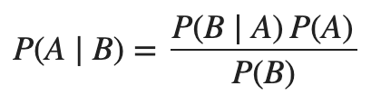
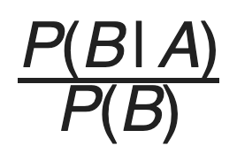
Bayes’ Rule (Bayes’ Law or Bayes’ Theorem)
For events A and B:
P (A), the prior, is the initial degree of belief in A.
P (A | B), the posterior is the degree of belief having accounted for B.
The quotient represents the support B provides for A.
The key to Bayesian statistics is that as we gain more information, we can update our prior distribution and calculate an update posterior. Bayesian Statistics is about learning new information.

Slide 121
Implementing Bayes’ Rule
Open notebook 3-3_Bayes_Theorem.ipynb

Slide 122
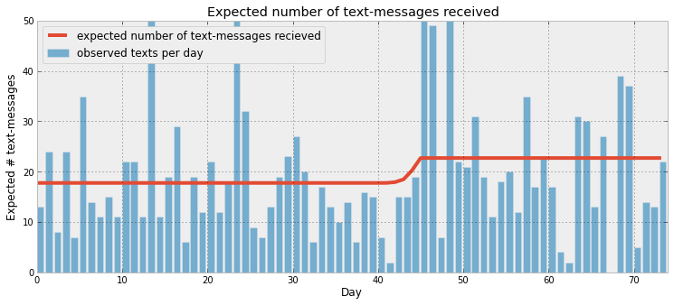
Guide to Bayesian Statistics
A great online pamphlet/book with Jupyter Notebooks examples that goes into much greater detail about Bayesian Statistics and implementation in Python that is beyond the scope of this course:
http://camdavidsonpilon.github.io/Probabilistic-Programming-and-Bayesian-Methods-for-Hackers/#contents

Slide 123
Homework
I recommend you spend a few hours during the coming week reviewing your notes, slides, and Jupyter notebooks to help record what we’ve done today into your long-term memory.
In addition, I have a brief assignment. I would like you to review the following link that clearly describes common statistical fallacies.
https://www.geckoboard.com/learn/data-literacy/statistical-fallacies/
Before next Saturday’s class, email me at dw858@georgetown.edu with the subject “Statistical Fallacy”, and in the body of the email give me a new example of one of the fallacies that you found interesting.

